Slide 1
No SQL vs SQL

Slide 2


Slide 3
What’s MongoDB?
MongoDB is an open-source NoSQL database written in C++ language. It uses JSON-like documents with optional schemas.
It provides easy scalability and is a cross-platform, document-oriented database.
MongoDB works on the concept of Collection and Document.
It combines the ability to scale out with features such as secondary indexes, range queries, sorting, aggregations, and geospatial indexes.
MongoDB is developed by MongoDB Inc. and licensed under the Server Side Public License (SSPL).

Slide 4
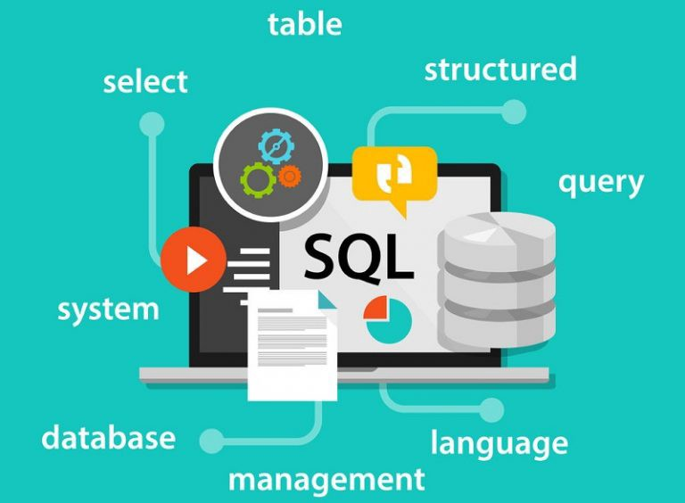

Slide 5
What’s SQL?
SQL (pronounced “ess-que-el”) stands for Structured Query Language. SQL is used to communicate with a database. According to ANSI (American National Standards Institute), it is the standard language for relational database management systems. SQL statements are used to perform tasks such as update data on a database, or retrieve data from a database. Some common relational database management systems that use SQL are: Oracle, Sybase, Microsoft SQL Server, Access, Ingres, etc.

Slide 6
Differentiate MongoDB and MySQL
Despite MySQL and MongoDB being freeware and open source databases, there are several differences between them in terms of a data relationship, transaction, performance speed, querying data, schema design, normalization, etc. The comparison between MongoDB and MySQL is similar to the comparison between Non-relational and Relational databases.

Slide 7
